Slide 1
Heaps
CSC212: Data Structures

Slide 2
Special Types of Trees
Def: Full binary tree = a binary tree in which each node is either a leaf or has degree exactly 2.
Def: Complete binary tree = a binary tree in which all leaves are on the same level and all internal nodes have degree 2.
4
1
3
2
16
9
10
14
8
7
12
Full binary tree
4
1
3
2
16
9
10
Complete binary tree

Slide 3
Definitions
Height of a node = the number of edges on the longest simple path from the node to a leaf
Level/Depth of a node = the length of a path from the root to the node
Height of tree = height of root node
4
Height of root = 3
1
3
Height of (2)= 1
2
16
9
10
Level of (10)= 2
14
8

Slide 4
The Heap Data Structure
Def: A heap is a nearly complete binary tree with the following two properties:
  Structural property: all levels are full, except possibly the last one, which is filled from left to right
  Order (heap) property: for any node x
  Parent(x) ≥ x
From the heap property, it follows that:
“The root is the maximum
element of the heap!”
8
7
4
5
2
Heap
A heap is a binary tree that is filled in order

Slide 5
Sequential Representation of binary trees
There are three methods of representing a binary tree using array representation.
  1. Using index values to represent edges:
class Node<T> {
T data;
int left;
int right;
}
Node<T>[] BinaryTree=new Node[TreeSize];

Slide 6
Method 1: Example
A
Index | Element | Left | Right
1 | A | 2 | 3
2 | B | 4 | 6
3 | C | 0 | 0
4 | D | 0 | 0
5 | I | 0 | 0
6 | E | 7 | 0
7 | G | 5 | 0
B
C
D
E
G
I

Slide 7
Method 2
2. Store the nodes in one of the natural traversals:
class Node<T> {
T data;
boolean left;
boolean right;
};
Node<T>[] BinaryTree=new Node<T>[TreeSize];

Slide 8
Method 2: Example
A
Index | Element | Left | Right
1 | A | T | T
2 | B | T | T
3 | D | F | F
4 | E | T | F
5 | G | T | F
6 | I | F | F
7 | C | F | F
B
C
D
E
G
I
Elements stored in Pre-Order traversal

Slide 9
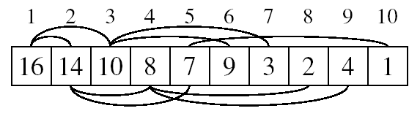
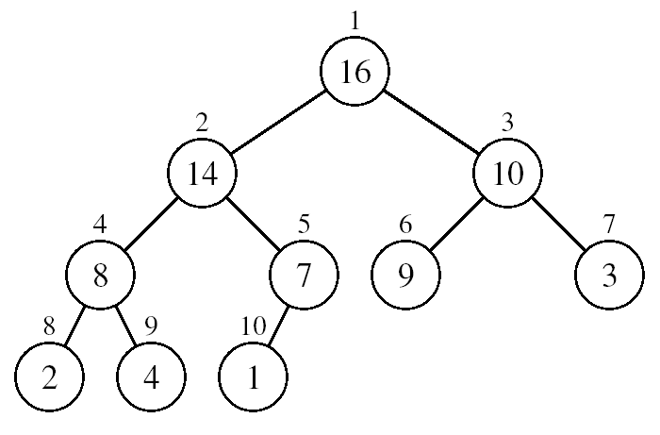
Array Representation of Heaps
A heap can be stored as an array A.
  Root of tree is A[1]
  Left child of A[i] = A[2i]
  Right child of A[i] = A[2i + 1]
  Parent of A[i] = A[ ⎣i/2⎦ ]
  Heapsize[A] ≤ length[A]
The elements in the subarray A[(⎣n/2⎦+1) .. n] are leaves

Slide 10
Heaps
Heaps are represented sequentially using the third method.
Heap is nearly complete binary tree: shortest-path length tree with nodes on the lowest level in their leftmost positions.
Complete Binary Tree: let h be the height of the heap
  for i = 0, … , h - 1, there are 2^{i} nodes of depth i
  at depth h - 1, all nodes in the last level are as far left as possible

Slide 11
Heap Types
Max-heaps (largest element at root), have the max-heap property:
  for all nodes i, excluding the root:
  A[PARENT(i)] ≥ A[i]
Min-heaps (smallest element at root), have the min-heap property:
  for all nodes i, excluding the root:
  A[PARENT(i)] ≤ A[i]

Slide 12
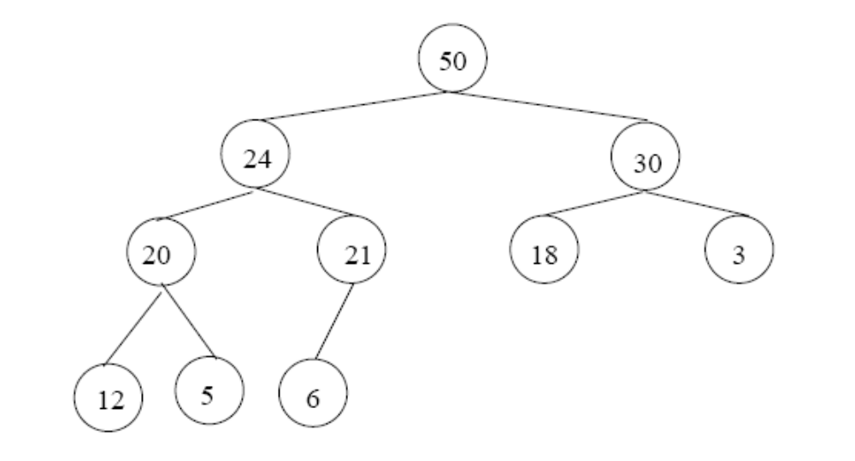
Adding/Deleting Nodes
New nodes are always inserted at the bottom level (left to right)
Nodes are removed from the bottom level (right to left)

Slide 13
Operations on Heaps
Maintain/Restore the max-heap property
  MAX-HEAPIFY or MIN-HEAPIFY
Create a max-or-min heap from an unordered array
  BUILD-MAX-HEAP or BUILD-MIN-HEAPIFY
Sort an array in place
  HEAPSORT
Priority queues

Slide 14
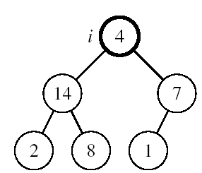
Maintaining Heap Property (MAX)
Suppose a node is smaller than a child
  Left and Right subtrees of i are max-heaps
To eliminate the violation:
  Exchange with larger child
  Move down the tree
  Continue until node is not smaller than children

Slide 15
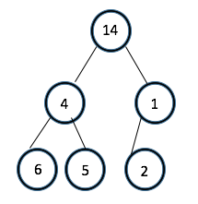
Maintaining Heap Property (MIN)
Suppose a node is larger than a child
  Left and Right subtrees of i are min-heaps
To eliminate the violation:
  Exchange with smaller child
  Move down the tree
  Continue until node is not larger than children

Slide 16
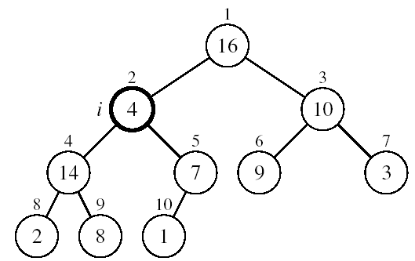
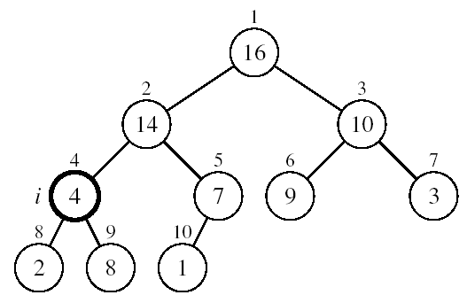
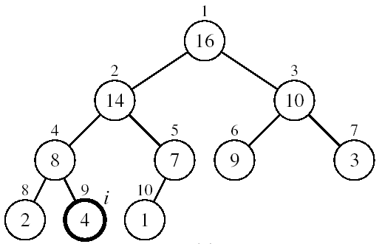
Example
MAX-HEAPIFY(A, 2, 10)
A[2] ↔ A[4]
A[2] violates the heap property
A[4] violates the heap property
A[4] ↔ A[9]
Heap property restored

Slide 17
Maintaining the Heap Property
Alg: MAX-HEAPIFY(A, i, n)
l ← LEFT(i)
r ← RIGHT(i)
if l ≤ n and A[l] > A[i]
then largest ←l
else largest ←i
if r ≤ n and A[r] > A[largest]
then largest ←r
if largest ≠ i
then exchange A[i] ↔ A[largest]
MAX-HEAPIFY(A, largest, n)
Assumptions:
  Left and Right subtrees of i are max-heaps
  A[i] may be smaller than its children

Slide 18
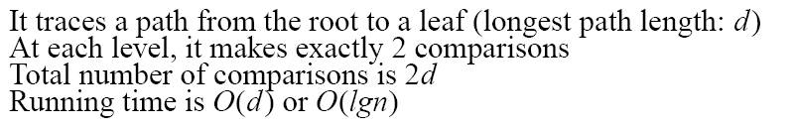
MAX-HEAPIFY Running Time
Intuitively:
Running time of MAX-HEAPIFY is O(lgn)
Can be written in terms of the height of the heap, as being O(h)
  Since the height of the heap is ⎣lgn⎦
-
h
-
-
-
2h
O(h)

Slide 19
Merging Two Heaps - Heap Down
We are given two heaps H1,H2 and a key k
We create a new heap with the root node storing k and with the two heaps as subtrees
We perform downheap to restore the heap-order property (Min-Heapify)
3
2
8
5
4
6
© 2010 Goodrich, Tamassia
Heaps

Slide 20
Merging Two Heaps - Heap Down
We are given two heaps H1,H2 and a key k
We create a new heap with the root node storing k and with the two heaps as subtrees
We perform downheap to restore the heap-order property (Min-Heapify)
k
7
3
2
8
5
4
6
© 2010 Goodrich, Tamassia
Heaps

Slide 21
Merging Two Heaps
We are given two heaps H1,H2 and a key k
We create a new heap with the root node storing k and with the two heaps as subtrees
We perform downheap to restore the heap-order property (Min-Heapify)
k
7
3
2
8
5
4
6
Merge
© 2010 Goodrich, Tamassia
Heaps

Slide 22
Merging Two Heaps
We are given two heaps H1,H2 and a key k
We create a new heap with the root node storing k and with the two heaps as subtrees
We perform downheap to restore the heap-order property (Min-Heapify)
7
3
2
8
5
4
6
Downheap/SiftDown
© 2010 Goodrich, Tamassia
Heaps

Slide 23
Merging Two Heaps
We are given two heaps H1,H2 and a key k
We create a new heap with the root node storing k and with the two heaps as subtrees
We perform downheap to restore the heap-order property (Min-Heapify)
2
3
7
8
5
4
6
Downheap/SiftDown
© 2010 Goodrich, Tamassia
Heaps

Slide 24
Merging Two Heaps
We are given two heaps H1,H2 and a key k
We create a new heap with the root node storing k and with the two heaps as subtrees
We perform downheap to restore the heap-order property (Min-Heapify)
2
3
4
8
5
7
6
Downheap/SiftDown
© 2010 Goodrich, Tamassia
Heaps

Slide 25
Bottom-up Heap Construction
We can construct a heap storing n given keys in using a bottom-up construction with log n phases
In phase i, pairs of heaps with 2^{i} −1 keys are merged into heaps with 2^{i+1}−1 keys
2^{i} −1
2^{i} −1
2^{i+1}−1
© 2010 Goodrich, Tamassia
Heaps

Slide 26
Building a Heap Bottom Up
Convert an array A[1 … n] into a max-heap (n = length[A])
The elements in the subarray A[(⎣n/2⎦+1) .. n] are leaves
Apply MAX-HEAPIFY on elements between 1 and ⎣n/2⎦
Alg: BUILD-MAX-HEAP(A)
n = length[A]
for i ← ⎣n/2⎦ downto 1
do MAX-HEAPIFY(A, i, n)
1
4
2
3
1
3
4
5
6
7
2
16
9
10
8
9
10
14
8
7
A:
4 | 1 | 3 | 2 | 16 | 9 | 10 | 14 | 8 | 7

Slide 27
Example: A
4 | 1 | 3 | 2 | 16 | 9 | 10 | 14 | 8 | 7
i = 5
i = 4
i = 3
1
1
1
4
4
4
2
3
2
3
2
3
1
3
1
3
1
3
4
5
6
7
4
5
6
7
4
5
6
7
2
16
9
10
2
16
9
10
14
16
9
10
8
9
10
8
9
10
8
9
10
14
8
7
14
8
7
2
8
7
i = 2
i = 1
1
1
1
4
4
16
2
3
2
3
2
3
1
10
16
10
14
10
4
5
6
7
4
5
6
7
4
5
6
7
14
16
9
3
14
7
9
3
8
7
9
3
8
9
10
8
9
10
8
9
10
2
8
7
2
8
1
2
4
1

Slide 28
Running Time of BUILD MAX HEAP
Alg: BUILD-MAX-HEAP(A)
n = length[A]
for i ← ⎣n/2⎦ downto 1
do MAX-HEAPIFY(A, i, n)
O(n)
O(lgn)
⇒ Running time: O(nlgn)
This is not an asymptotically tight upper bound

Slide 29
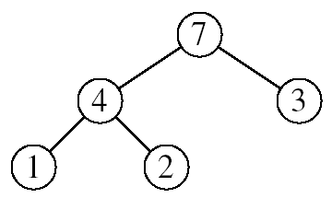
Heapsort
Goal:
  Sort an array using heap representations
Idea:
  Build a max-heap from the array
  Swap the root (the maximum element) with the last element in the array
  “Discard” this last node by decreasing the heap size
  Call MAX-HEAPIFY on the new root
  Repeat this process until only one node remains

Slide 30
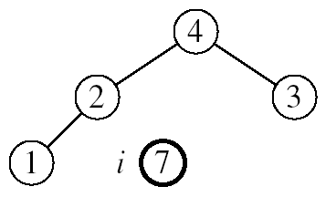
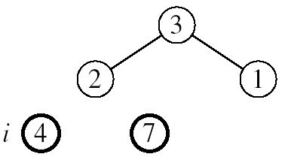
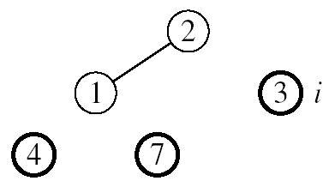
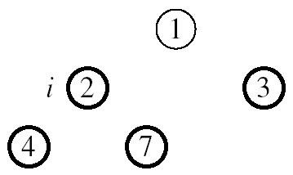

Example: A=[7, 4, 3, 1, 2]
MAX-HEAPIFY(A, 1, 4)
MAX-HEAPIFY(A, 1, 3)
MAX-HEAPIFY(A, 1, 2)
MAX-HEAPIFY(A, 1, 1)

Slide 31
Alg: HEAPSORT(A)
BUILD-MAX-HEAP(A)
for i ← length[A] downto 2
do exchange A[1] ↔ A[i]
MAX-HEAPIFY(A, 1, i - 1)
Running time: O(nlgn) --- Can be shown to be Θ(nlgn)
O(n)
n-1 times
O(lgn)

Slide 32
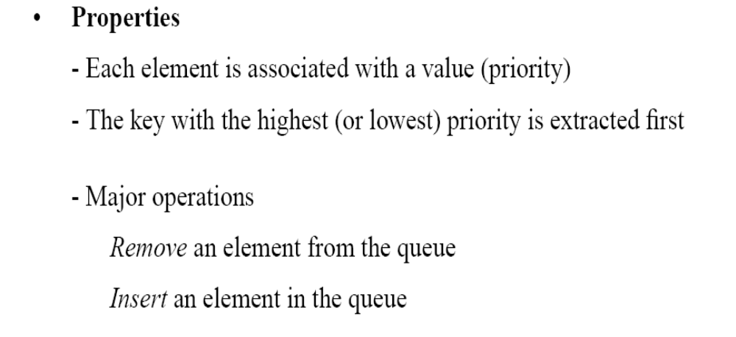
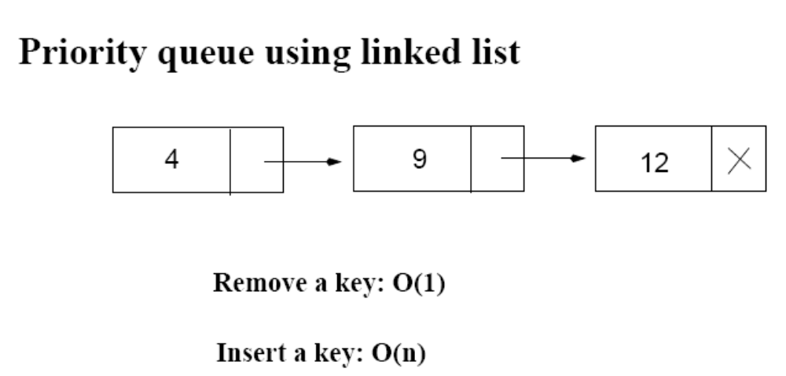
Priority Queues
12
4

Slide 33
Operations on Priority Queues
Max-priority queues support the following operations:
  INSERT(S, x): inserts element x into set S
  EXTRACT-MAX(S): removes and returns element of S with largest key
  MAXIMUM(S): returns element of S with largest key
  INCREASE-KEY(S, x, k): increases value of element x’s key to k (Assume k ≥ x’s current key value)

Slide 34
HEAP-MAXIMUM
Goal:
  Return the largest element of the heap
Alg: HEAP-MAXIMUM(A)
return A[1]
Running time: O(1)
Heap A:
Heap-Maximum(A) returns 7

Slide 35
HEAP-EXTRACT-MAX
Goal:
  Extract the largest element of the heap (i.e., return the max value and also remove that element from the heap
Idea:
  Exchange the root element with the last
  Decrease the size of the heap by 1 element
  Call MAX-HEAPIFY on the new root, on a heap of size n-1
Heap A:
Root is the largest element

Slide 36
Example: HEAP-EXTRACT-MAX
16
1
14
10
max = 16
14
10
8
7
9
3
8
7
9
3
2
4
1
2
4
Heap size decreased with 1
14
Call MAX-HEAPIFY(A, 1, n-1)
8
10
4
7
9
3
2
1

Slide 37
HEAP-EXTRACT-MAX
Alg: HEAP-EXTRACT-MAX(A, n)
if n < 1
then error “heap underflow”
max ← A[1]
A[1] ← A[n]
MAX-HEAPIFY(A, 1, n-1) remakes heap
return max
Running time: O(lgn)

Slide 38
HEAP-INCREASE-KEY
Goal:
  Increases the key of an element i in the heap
Idea:
  Increment the key of A[i] to its new value
  If the max-heap property does not hold anymore: traverse a path toward the root (SiftUp) to find the proper place for the newly increased key
16
14
10
8
i
7
9
3
Key [i] ← 15
2
4
1

Slide 39
Example: HEAP-INCREASE-KEY
16
16
14
10
14
10
8
i
7
9
3
8
i
7
9
3
2
4
1
2
15
1
Key [i ] ← 15
16
16
i
14
10
15
10
i
15
7
9
3
14
7
9
3
2
8
1
2
8
1

Slide 40
HEAP-INCREASE-KEY
Alg: HEAP-INCREASE-KEY(A, i, key)
if key < A[i]
then error “new key is smaller than current key”
A[i] ← key
while i > 1 and A[PARENT(i)] < A[i]
do exchange A[i] ↔ A[PARENT(i)]
i ← PARENT(i)
Running time: O(lgn)
16
14
10
8
i
7
9
3
2
4
1
Key [i] ← 15

Slide 41
MAX-HEAP-INSERT
Goal:
  Inserts a new element into a max-heap
Idea:
  Expand the max-heap with a new element whose key is -∞
  Calls HEAP-INCREASE-KEY to set the key of the new node to its correct value and maintain the max-heap property
16
14
10
8
7
9
3
2
4
1
-∞
16
14
10
8
7
9
3
2
4
1
15

Slide 42
Example: MAX-HEAP-INSERT
Insert value 15:
- Start by inserting -∞
Increase the key to 15
Call HEAP-INCREASE-KEY on A[11] = 15
16
16
14
10
14
10
8
7
9
3
8
7
9
3
2
4
1
-∞
2
4
1
15
The restored heap containing
the newly added element
16
16
14
10
15
10
8
15
9
3
8
14
9
3
2
4
1
7
2
4
1
7

Slide 43
MAX-HEAP-INSERT
Alg: MAX-HEAP-INSERT(A, key, n)
heap-size[A] ← n + 1
A[n + 1] ← -∞
HEAP-INCREASE-KEY(A, n + 1, key)
16
14
10
8
7
9
3
2
4
1
-∞
Running time: O(lgn)

Slide 44
Summary
We can perform the following operations on heaps:
  MAX-HEAPIFY O(lgn)
  BUILD-MAX-HEAP O(n)
  HEAP-SORT O(nlgn)
  MAX-HEAP-INSERT O(lgn)
  HEAP-EXTRACT-MAX O(lgn)
  HEAP-INCREASE-KEY O(lgn)
  HEAP-MAXIMUM O(1)
Average
O(lgn)

Slide 45
Priority Queue Using Linked List
12
4
Average: O(n)
Increase key: O(n)
Extract max key: O(1)

Slide 46
Problems
Demonstrate, step by step, the operation of Build-Heap on the array
A=[5, 3, 17, 10, 84, 19, 6, 22, 9]

